Slide 1
Queue

Slide 2
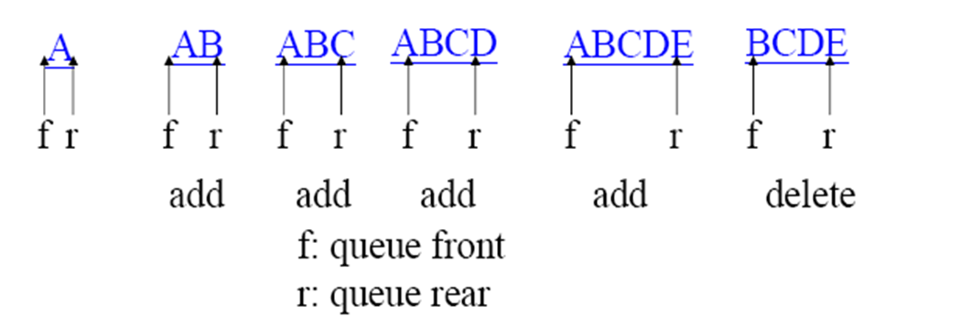
Queue
A queue is also known as a First-In-First-Out (FIFO) list.
A queue is a linear list of elements in which deletions can take place only at one end, called the front, and insertion can take place only at the other end called the rear.

Slide 3





Queue-Real world example

Slide 4
Queue-Applications
FCFS ( first come first serve) scheduling
Spooling in printers
Buffer for devices like keyboard
Queues in routers/ switches
Mail Queues
When a resource is shared among multiple consumers. Examples include CPU scheduling, disk scheduling
Implementation of graph(Breadth first search uses Queue)

Slide 5
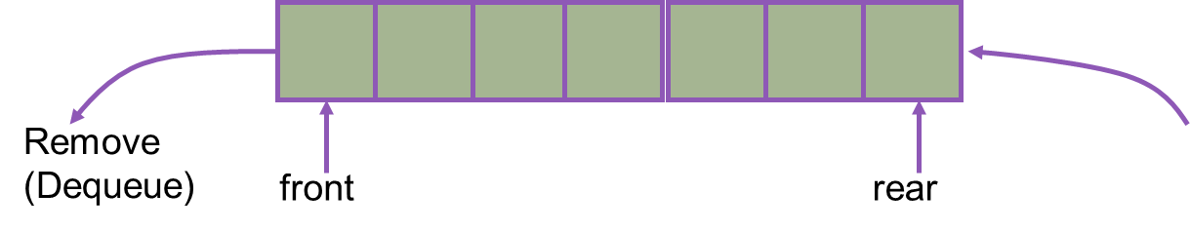
Queue Operations
Enqueue()
Inserts an element at the rear of the queue.
if rear reaches to maximum size then “queue is full”
Dequeue()
Removes an element from the front of the queue; an error occurs if the queue is empty.
If front is -1 “queue is empty” or “front= rear+1 “queue is empty.
Insert (Enqueue)

Slide 6

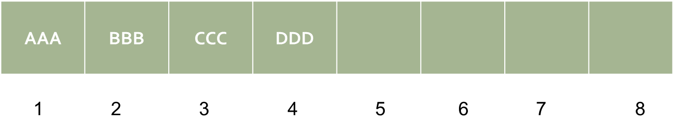
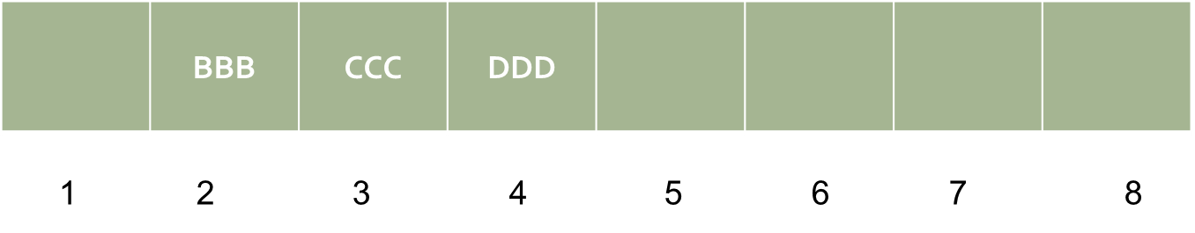
Implementing a Queue using Array
Front:2, Rear:4

Slide 7
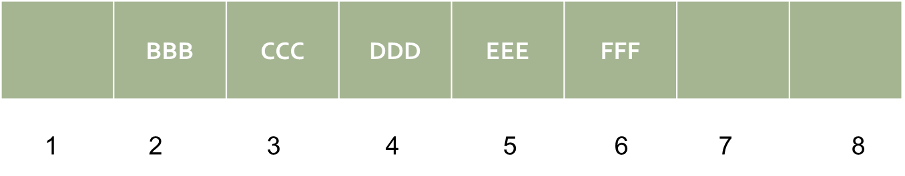
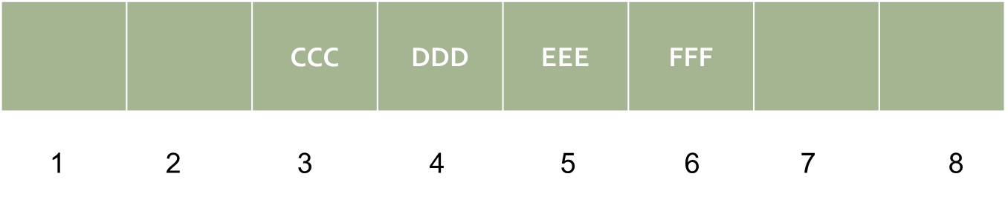
Implementing a Queue using Array
Front:2, Rear:6
Front:3, Rear:6

Slide 8
Algorithm to insert data in a Queue
FRONT = -1, REAR = -1, // To represent Queue is empty
Enqueue (QUEUE[N],FRONT,REAR,ITEM) //QUEUE is an array of size N ,ITEM is element to be inserted.
{
1. if (REAR == N-1)
1.1 Print “OVERFLOW”
else
1.1 if (FRONT == -1)
1.1.1 FRONT = 0
1.2 REAR = REAR+1
1.3 QUEUE[REAR] = ITEM }

Slide 9
Algorithm to delete data from a Queue
DeQueue(QUEUE[N],ITEM,FRONT,REAR)
{
1. if (( FRONT == – 1 ) || (FRONT == REAR+1))
1.1 Print “QUEUE EMPTY”
2. else
2.1 ITEM = QUEUE[FRONT]
2.2 FRONT = FRONT +1
}

Slide 10
Circular Queue
Suppose we want to insert an element into the queue after it occupies the last part of the array i.e. REAR=n.
One way of doing it is simply move the entire queue to the beginning of the array, changing FRONT and REAR, and then inserting the element. This procedure may be very expensive.
This can be done assuming that the array QUEUE is circular that is the QUEUE[1] comes after QUEUE[N] in the array. Instead if increasing REAR to N+1 we reset REAR=1.

Slide 11
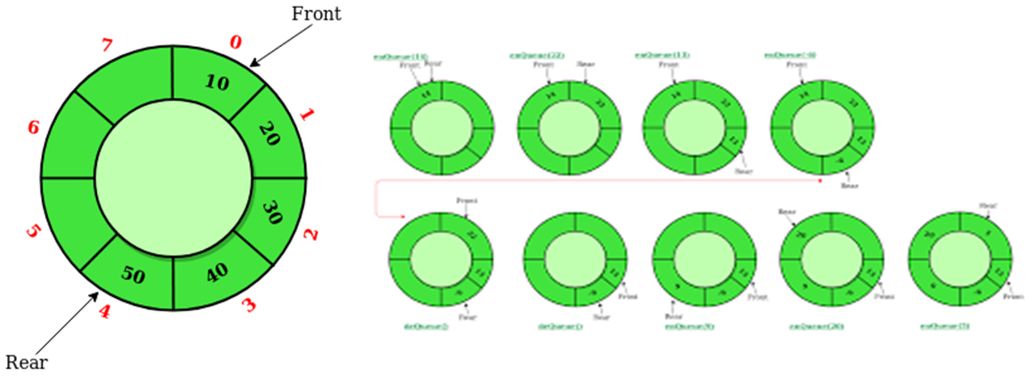
Circular Queue

Slide 12
Algorithm to insert data in a Circular Queue
FRONT = -1, REAR = -1, // To represent Queue is empty
Enqueue(QUEUE[N],FRONT,REAR,ITEM) //QUEUE is an array of size N ,ITEM is element to be inserted.
{ if ((FRONT == REAR+1) || ((FRONT == 0) && (REAR == N-1)))
1.1 DISPLAY “QUEUE OVERFLOW”
1.2 exit
2. else
2.1 if(FRONT == -1)
2.1.1 FRONT = 0
2.1.2 REAR = 0
2.1 else if ( REAR == N-1 && FRONT!=0)
2.1.1 REAR = 0
2.1 else
2.1.1 REAR = REAR + 1
2.2 QUEUE[REAR] = ITEM

Slide 13
Algorithm to delete data in a Circular Queue
FRONT = -1, REAR = -1 // To Represent Queue is empty
Dequeue(QUEUE[N],FRONT,REAR,ITEM)
{
1. if (FRONT == -1) 1.1 DISPLAY “QUEUE UNDERFLOW”
2. else
2.1 ITEM = QUEUE[FRONT]
2.2 if(FRONT== REAR)
2.2.1 FRONT = -1
2.2.2 REAR =-1
2.2.3 EXIT
2.2 else if ( FRONT == N-1 )
2.2.1 FRONT = 0
2.2.2 EXIT
2.2 else
2.2.4 FRONT = FRONT + 1 }

Slide 14
Exercise
Consider a circular queue with six memory cells.
QUEUE: _,A,C,D,_,_ Front=2,REAR=4
Add F
Two letters are deleted
Add K,L and M
Two letters are delete
Add R
Two letters are delete
Add S
Two letters are delete
One letter is delete
One letter is delete

Slide 15
Priority Queue
A priority queue is a collection of elements such that each element has been assigned a priority and such that the order in which the elements are deleted and processed comes from the following rules:
An element of higher priority is processed before any element of lower priority.
Two elements of the same priority are processed according to the order in which they were add to the queue.

Slide 16
Priority Queue
Sometimes, we have queues that are not FIFO i.e. the person who comes first may not leave first.
We can develop such queues in which the condition for leaving the queue is not to enter first. There may be some priority.
We will develop the queue in such a way that we will get the event which is going to happen first of all in the future. This data structure is known as priority queue.
In a sense, FIFO is a special case of priority queue in which priority is given to the time of arrival.
In operating systems, we have queue of different processes. If some process comes with higher priority, it will be processed first

Slide 17
Priority Queue-Applications
Hospital Emergency Queue
Waiting queue of passengers at airport(business class/economy class)
Task Scheduling
Network Routing

